Slide 1
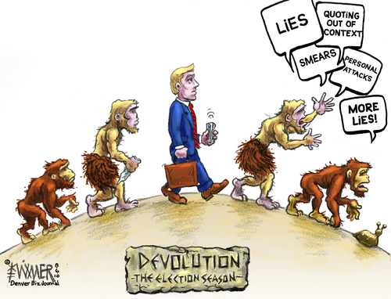
Evolution of Congress
Unit 2: Interactions Among the Branches

Slide 2
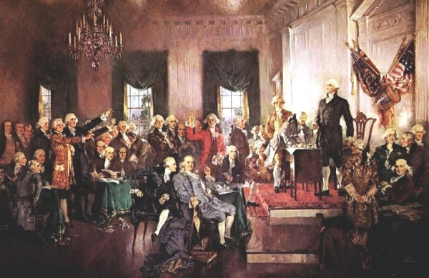
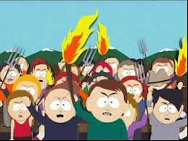
I. Intention of Founders
Fear of excessive power concentrated in single institution
Fear of mob rule by impassioned majority
Concern about manner of representation in Congress
*Note- As you study this, you MUST
Be able to recognize where this is
Present in design

Slide 3
Recognizing Intent in Design & Application
Half Dome-Yosemite
Wilshire Grand Hotel

Slide 4
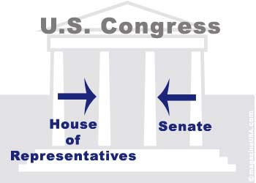
Solutions to these concerns: bicameral legislature
Belief that Congress would be dominant branch of gov’t
HOUSE
SENATE
Passions of the people are cooled

Slide 5
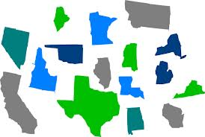
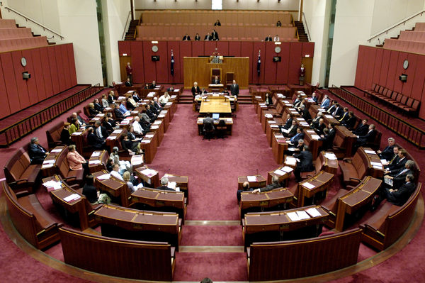
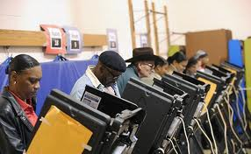
II. Development in the Senate towards Democratization
Democratization of Senate passage of the 17th amendment → direct election of senators
O.G.
17th A.

Slide 6
Chickety Check Yo Self…
How is the HOR elected?
How was the senate elected under OG Const?
How is Sen elected now? What changed it?
How does the “Hot Coffee-Saucer” analogy calm the passions of the people?

Slide 7
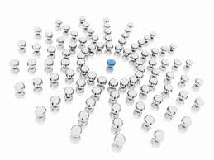
III. Conflict over distribution of power in the Congress
Basic conflict: Centralization v. Decentralization
Centralization would allow Congress to act quickly and decisively, but at the expense of individual members and the constituents whom they represent.

Slide 8
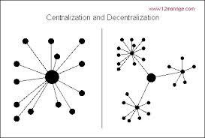
Decentralization would protect and enhance the interests of individual members and their constituents, but would prevent Congress from acting quickly and decisively.

Slide 9
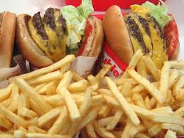
IV. Breaking Down the Power Struggle
Back to our example for majority rule…
When groups of people have a particular perspective and goal to achieve…what do they do as a group?
This is called being partisan…
VS.

Slide 10
Our dead gazelle…again…

Slide 11
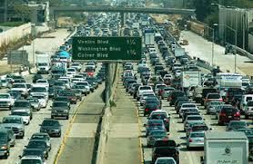
Putting this into Political Language
This dynamic where members of Congress will push the interests of their political parties is called…
Partisanship
Partisan Politics has been at the center of the most recent debates regarding our policy making effectiveness…
A visual to process:

Slide 12
The Work of Committees
The process of writing legislation is long, painful, and requires many voices ( 435 in the HOR & 100 in Senate)
To distribute this process, Congress uses the Committee system to remedy this problem of writing legislation
Committees do the following:
Review & edit language of legislation
Hearings (Facebook CEO Mark Zuckerberg on Privacy)
Oversight
Report on legislation to the full HOR & Senate

Slide 13
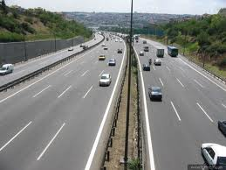
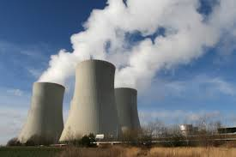
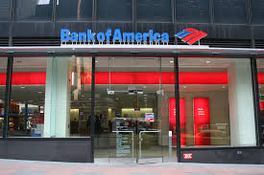
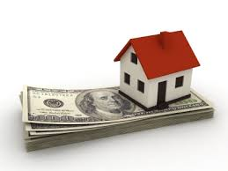
V. How Power is Decentralized using Committees
HOR
SENATE
Committee on Transportation & Energy (Chair)
Sub Comm on Sub Comm on
Highways (chair) Nuclear Energy
Committee on Finance (Chair)
Sub Comm on Sub Comm on
Banking (Chair) Mortgages(Chair)

Slide 14
VI. In come the 70s…
Decentralization in the 1970s (esp. w/ “Class of ‘74”)
Power of individual members over committee
# of sub committees
Power of Subcommittee Chairmen

Slide 15
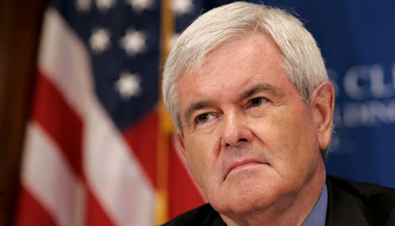
VII. Development in 90s (More decentralization)
Election of the 104th Congress (94-96)-Republican take over of Congress
Leadership under Speaker Gingrich
Under Gingrich 2 things changed:
a. Term limits for committee chairman (1 term for 6 yrs)
b. Senior Republicans
replaced by younger Reps
for Chairs on Comms

Slide 16
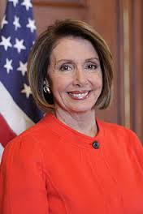
VIII. Congress Under Democrat Control 2006-2010
Speaker Pelosi’s “Hundred Congress” of 2007: In the first 100 days of the 110th Congress did:
House voted to raise the fed. minimum wage
Allow federally funded embryonic stem cell research
Implement recommendations of 9/11 commission
Cut student loan rates

Slide 17
Processing Leadership & Partisanship
How can leadership and partisanship affect the way Congress looks and acts?
For example:
Former Speaker of the House “The Boehner” wants to block President Obama’s plan to continue funding Planned Parenthood (controversy over abortions and use of embryonic stem cells [an issue Republicans are against].
What role does the “Boehner” and partisanship play in this scenario?

Slide 18
Essential Knowledge
Identify and describeTWO ways the Congress has moved to become more Democratic since the “Original Constitution”
Select ONE of the following and explain how it demonstrates the movement towards Decentralization
Committee System of the 1970s
Contract with America 1994

