Slide 1
Interest Groups: Reasons for Growth
Unit 5: Political Participation
Unit 2: Branches

Slide 2
Putting Interest Groups in Context
Issue: Gun Control – in Context of mass shootings
Gun Control Debate Post San Bernardino Shooting
Two sides on issues = two different interests = BOTH sides want different legislation to resolve issue

Slide 3
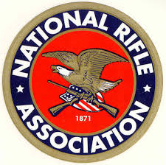
I. What is an Interest Group? Group w/ common interest seeking to influence gov’t

Slide 4
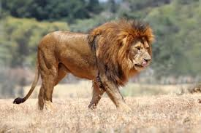
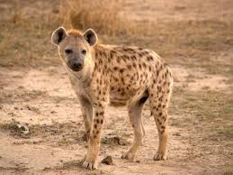
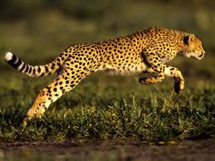
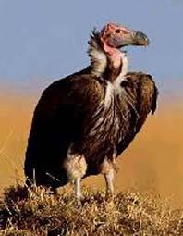
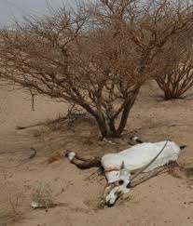
Democracy in Action: The Dead Gazelle

Slide 5
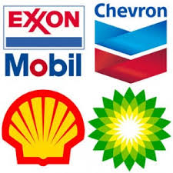
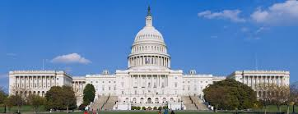
Democracy in Action: Interest Groups Politics

Slide 6
Madison’s dilemma (Fed #10)
Wanting both liberty & order → people have liberty to form groups & express views BUT…could create disorderly society → Therefore→
Belief: pol. factions were inevitable e.g. →need to control their effects

Slide 7
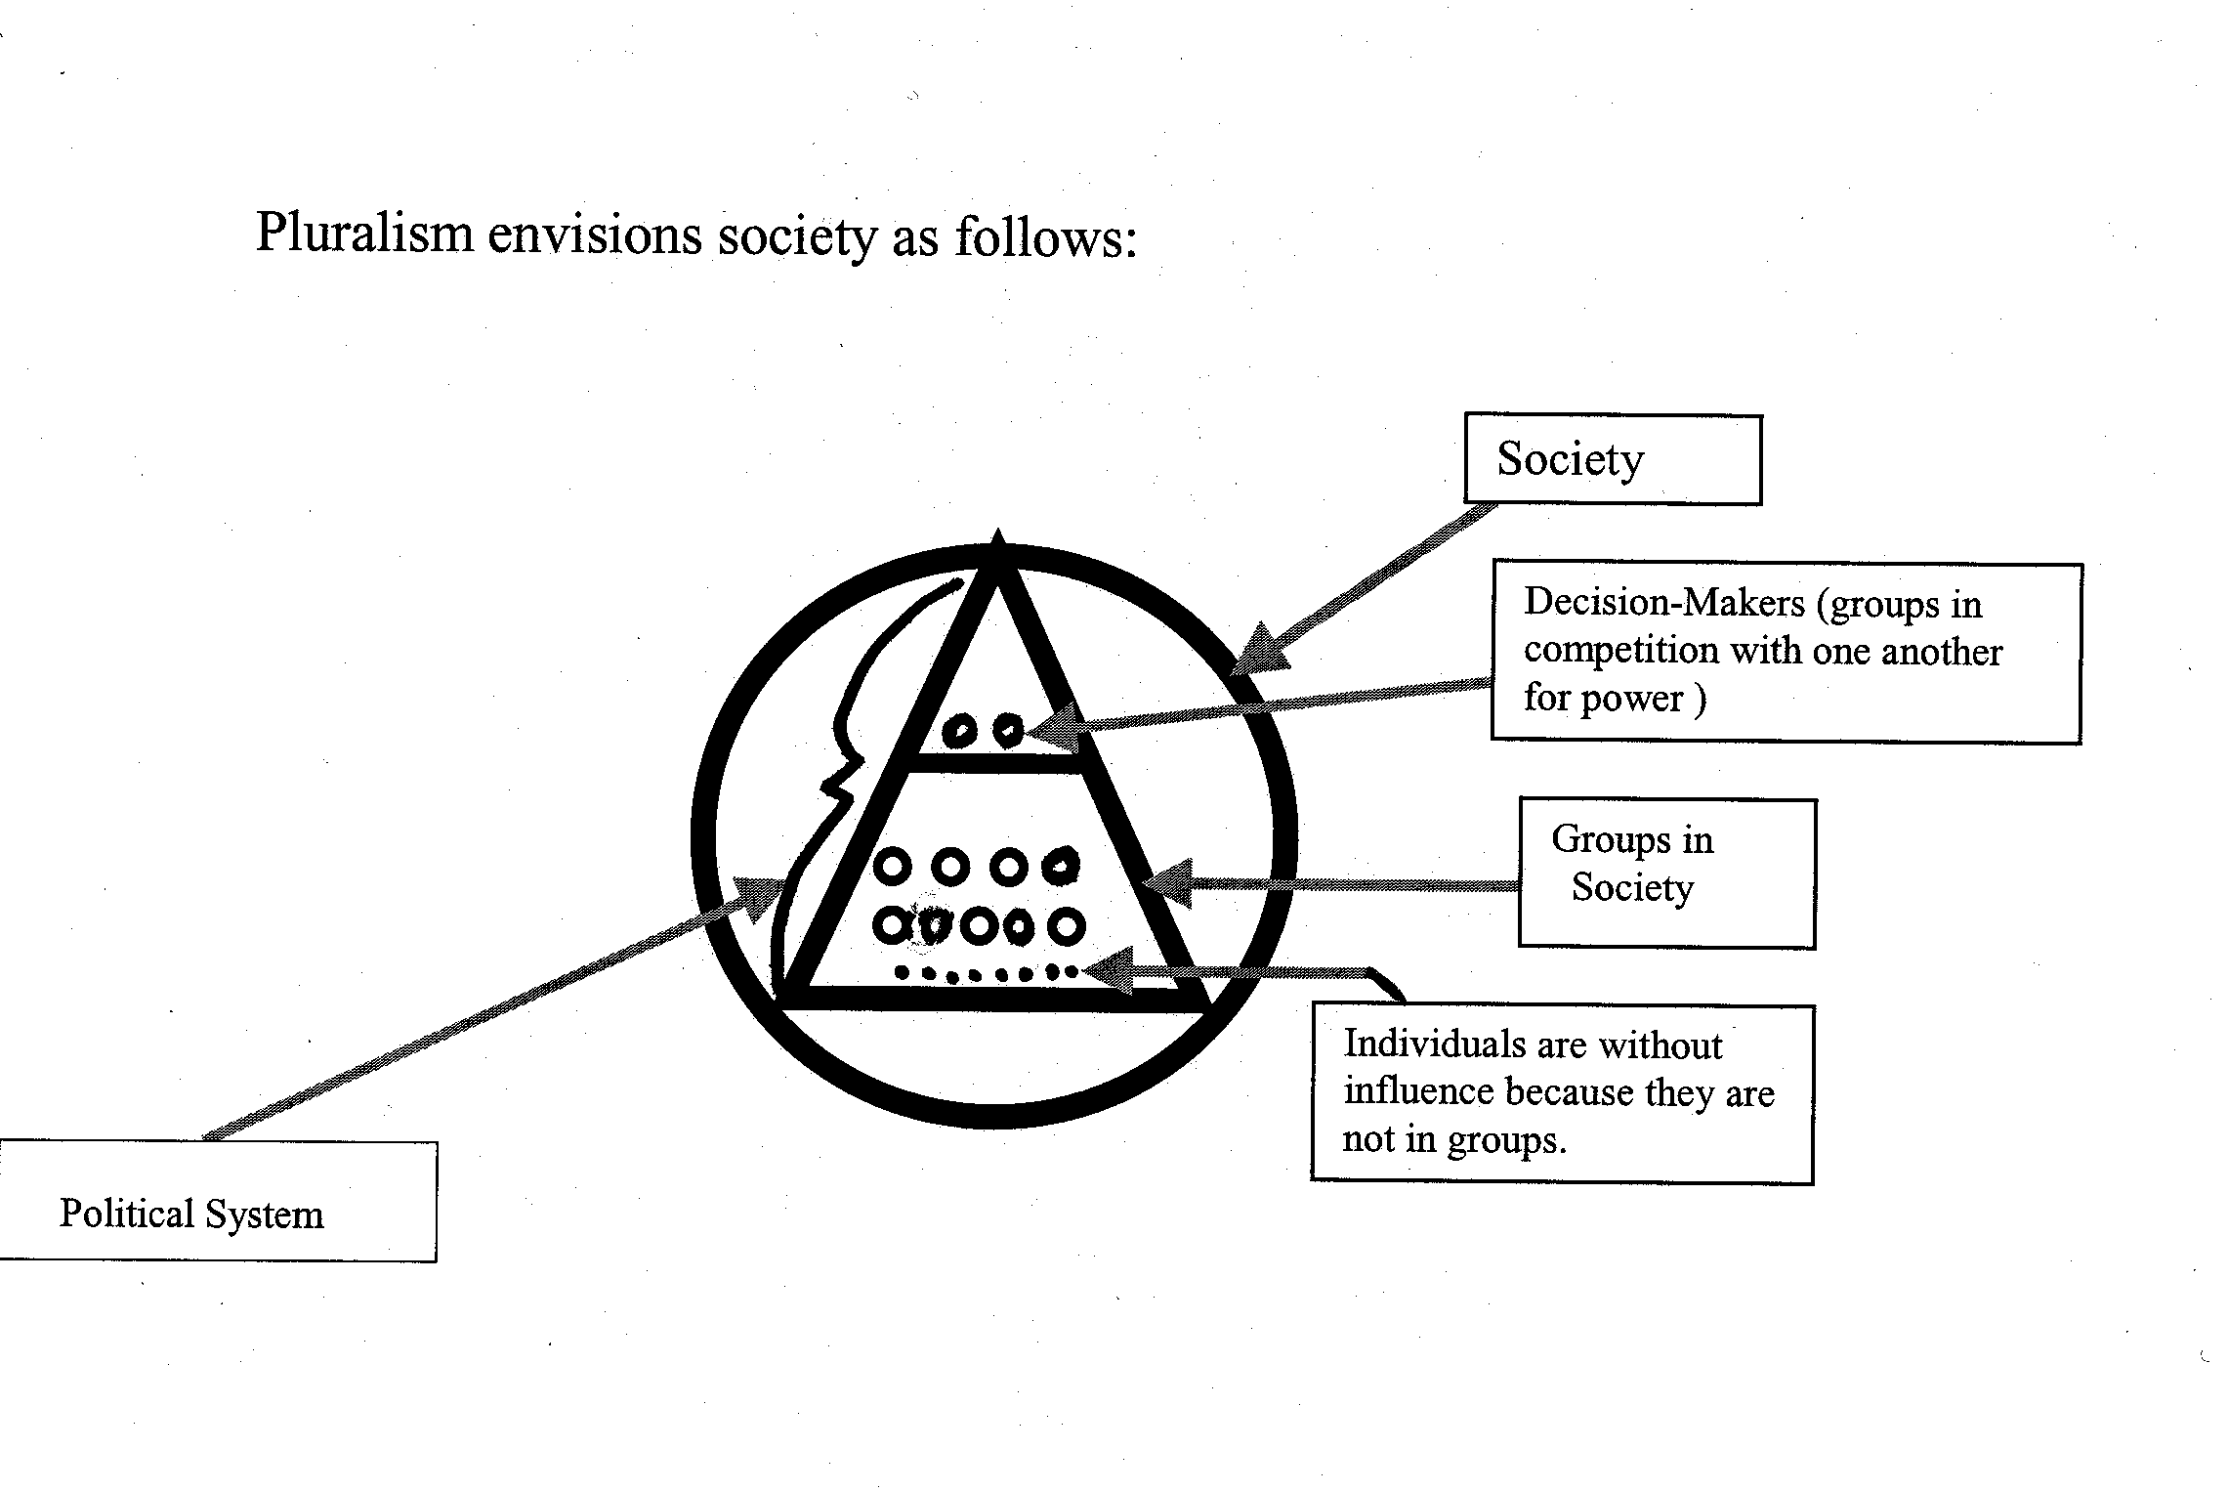
Pluralism: growth of int. groups stops concentration of excessive pwr in hands few →
enhances democracy →
flipside: groups don’t have = resources and = access

Slide 8
The Iron Triangle (Issue Network)
Issue: Gun Control – in Context of mass shootings
This is a visual for what the relationship(s) ending up looking like and working
Congressional Committee
Passes regulation (laws) on stricter gun access
Interest Group(s) NRA & Gun Control Group
Executive Agency
Enforces those regulations & deals with small details to make regulation work
Lobbies (persuades) Congressional members to change laws

Slide 9
II. Reasons for growth
There are over 4,100 registered interest groups with Congress
Take a look at some of the major groups and the issues they represent
VoteSmart.org

Slide 10
Econ developments, i.e. farm problems in 30s (dust bowl)
Gov’t policies: gov’t creates agency → entry pt for IG; i.e. New Deal & Great Society created many agencies → more IG needed to save stake in agencies
C. Diversity of population: social, racial, economic, geographic differences

Slide 11
Diffusion of power in gov’t → pwr shared by many = many places for groups to argue their particular case
Weakness of pol. parties: when parties not able to get things done, IGs have filled shoes
Reforms of 1970s: opened up lobbying process i.e. FECA and rise of PACs, also BCRA

Slide 12
IG formed → more IGs to counter it
Technology: computerized mailing lists to get $, open communications
Campaign Donations i.e. PACs has changed the game and influence of IGs in American politics

Slide 13
III. Tactics/Strategies of IGs

Slide 14
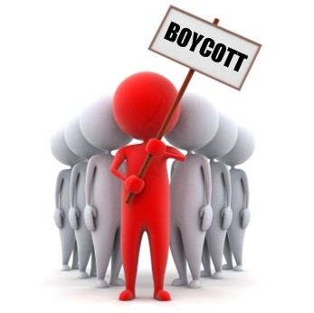
Use of mass media & social media
Boycotting: Examples
NOW’S boycott of states that didn’t ratify ERA,
Civil rights groups boycotting S. Carolina because of that state flying the Confederate flag at the state capital.

Slide 15
Litigation-Law suits in courts-
This has proven to the most successful
All parties want to avoid losing in court and prevent the high costs of suits
To prevent, this can have huge leverage

Slide 16
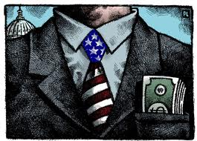
4. Campaign contributions
Endorsement of candidates
“Targeting” of unfriendly candidates,
Ex: moveon.org in 2004 vs Bush
7. Issuing “report cards” to rate candidates

Slide 17
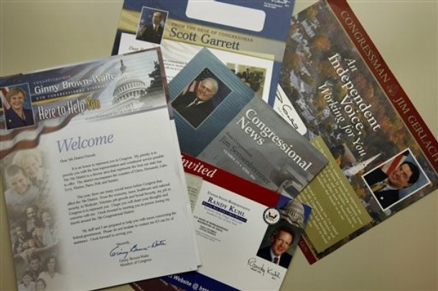
8. Initiatives, referendums and recalls at state and local levels
Lobbying
Mass mailings. New techniques of targeting specific segments of population w/ database software

Slide 18
Essential Knowledge Statements
Discuss why Madison felt factions were inevitably important
2. Describe 2 reasons for the growth of interest groups
3. Explain how 2 strategies IGs use to influence policy

