Slide 1
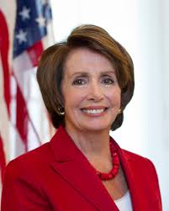
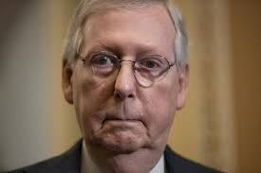
Leadership in Congress
Unit 2: Branches

Slide 2
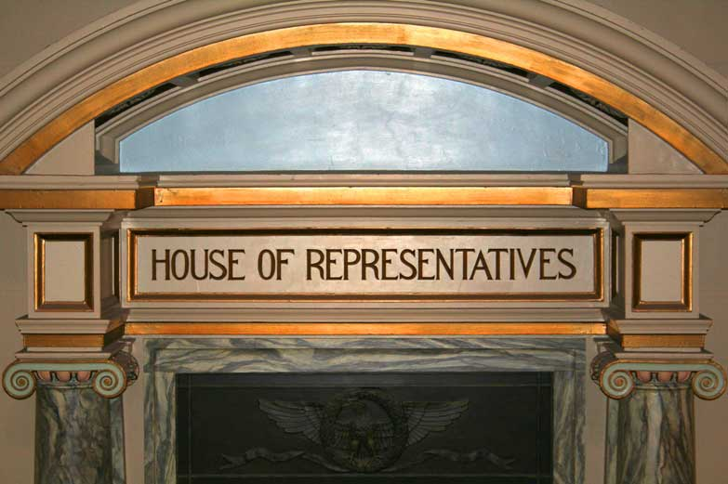
I. House of Reps.

Slide 3
Speaker
Presides over House
Appoints select and conference committees
Appoints Rules Committee members and its chairman
Assigns bills to committees
Third in line for presidency after VP
Informal powers i.e. access to media

Slide 4
Chew on This! How does this position influence law making?

Slide 5
Majority leader/Minority Leader
Partisan positions chosen by party members
Floor (where voting happens) leaders and legislative strategists
Keep Chewing on This!
How does this position influence law making?

Slide 6
Majority Whip/Minority Whip
Assistant to floor leaders
Inform party leaders on “mood” of House
Keep nose count on important votes
Persuade party members to vote with party
Liaison between party leadership and rank and file membership

Slide 7
Like the flavor? No? Keep chewing…!
How does this position influence law making?

Slide 8
II. Senate

Slide 9
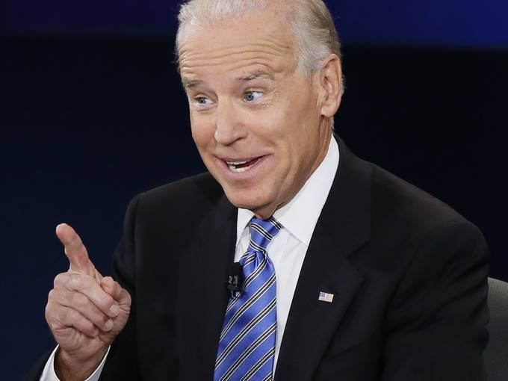
Vice President
Pres of Senate
Presides over Senate
Votes in case of ties
Ceremonial job

Slide 10
Chew on This!
How does this position influence law making?

Slide 11
President Pro Tempore
Ceremonial job
Presides in absence of VP
Fourth in line for presidency
Mastication the revenge!
Why do you think this is a ceremonial job?

Slide 12
Majority Leader
True leader in Senate
Recognized first for all debates
True leader of majority party
Influences committee assignments for senators
Influences Senate agenda, along with Minority Leader
Informal powers i.e. use of media

Slide 13
You are burning calories now with all your chewing!
How is this similar or different to Speaker of the House?

Slide 14
Minority Leader and Party Whips: Same as House
The longer you chew the more you help with digestion!-Get it?????
They call you guys the chewers!!

Slide 15
Essential Knowledge
Note- modified version of Question #2- FRQ 2003
Identify 2 ways party leadership in Congress can influence legislative process.
Explain how “partisan politics” impacts leadership in each way identified above
(Ex: How Speaker of the House impacts the whole House of Reps)

