Slide 1
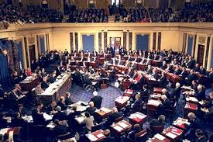
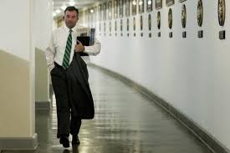
Overview of Congress
Unit 2: Interactions Among the Branches

Slide 2
Essential Question(s) for Unit 2
How do the branches of the national government compete and cooperate in order to govern?
To what extent have changes in the powers of each branch affected how responsive and accountable the national government is in the 21st century?
This is what Congress looks like- this our current Congress- the 115th Congress
Opening Day of 115th Congress (H.O.R.)
VP Joe Biden Swears in Senate

Slide 3
I. Terms and sessions
Term of congress lasts two years
Terms begin on Jan.3 of every odd-number year
Terms numbered consecutively (108th from 03-05,109th from 05-07, 110th from 07-09, 111th 09-11, 112th from 11-13, 113th from 13-15, 114th-15-17, 115th-17-19, 116th-19-21(*current Congress)
Adjournment: end of term; date must be agreed upon by both houses.
Two regular sessions per term. Periodic recesses (not to be confused w/ adjournment)

Slide 4
II. Bicameralism: two-house legislature
A. House of Rep’s was designed to be closer to the people
B. Senate was designated to be more removed from the people
218 is majority
246 Republicans
186 Democrats
3 vacancies
*114th Congress
*9/9/16

Slide 5
III. House of Representatives
Size
Determined by Congress. 435 since 1911
Members elected by districts, not states
Each district represents roughly 650,000 people per rep (This is the proportional representation from Great Compromise)
They are known as Congressional Districts (CDs for short)
i.e. we are in CD 43, I am in CD 34
Maxine Waters (D) CD 43 CA
Jimmy Gomez (D) CD 34 CA

Slide 6
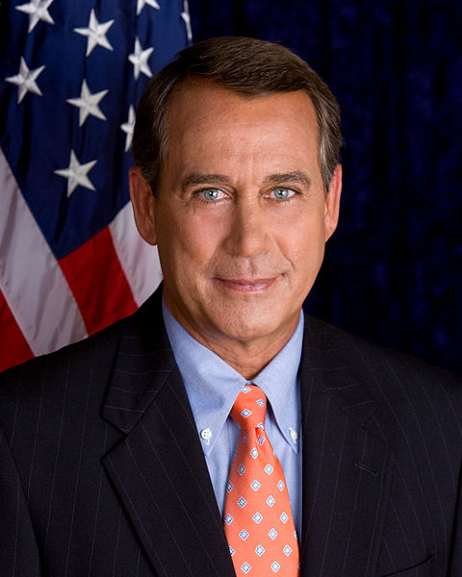
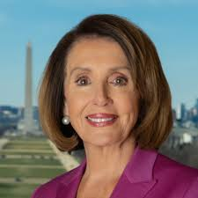
B. Terms of office are fixed, meaning they do not change (i.e. HOR 2 yrs- Sen- 6 yrs)
C. Qualifications: 25 years of age, citizenship; 7 years of residency in state
Former Speaker of the House- John Boehner (R) OH CD 8
Current Speaker of the House
Nancy Pelosi
(D) CA CD 12

Slide 7
IV. Senate
Size: 100 members, chosen in statewide elections- “At Large”- Meaning the WHOLE state votes. With a smaller size, the Senate has been a more informal body with less need than the House for as many strict procedures
52 Republicans
47 Democrats
2 Independents who caucus with Dems
*Current party divisions for new Senate

Slide 8
B. Terms of office: Six years. 1/3 up for reelection every two years→ 2/3 are not being re-elected→Staggering of terms ensures a more stable body. No term limits allowed here, either.
C. Qualifications: 30 years of age, citizenship; 9 yrs of residency in state
Senate Majority Leader-
Mitch McConnell (R) KY
Kamala Harris(D) CA
Diane Feinstein (D) CA

Slide 9
V. Compensation
Members set own salaries. 27th Amendment prevents salary raises from taking effect until the following term. (2007 salaries: $168,500).
(2009 increase: $174,000)
B. Many other perks: travel allowance, office space, franking privilege, insurance, etc.

Slide 10
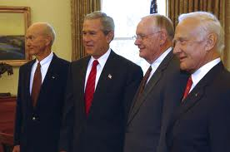
VI. Membership
Overrepresentation of white, male, Protestant, upper-middle class lawyers in their 50s → charges of conservative/status quo bias.
B. Rebuttals

Slide 11
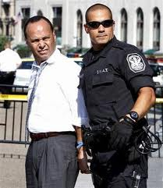
Legislative immunity: cannot be sued for something they say while on congressional business
Cannot be arrested/detained while going to or from a session of Congress

Slide 12
Essential Knowledge
Create a chart for yourself with the most important distinguishing aspects of both houses (Use the matrix documents if you’d like)
*Note- These are all the basics of Congress that you need to know VERY well. “Make it Work”

Slide 13
