Slide 1
Incumbency, Reapportionment, & Redistricting
Unit 2: Interaction Among the Branches

Slide 2
What You Are Doing Today
Before we get into the REAL technical aspect of these concepts…
You will do a hands on case study to better understand by actually doing…
You are going to reapportion and redistrict the great state of Morgana & state of Matthews using beans, butcher paper, pencils & erasers

Slide 3
Some Basics to remember
How are HOR members elected?
What is the HOR representation based on?
What is a census?
What is reapportionment?
What is redistricting?
Here is how all this works:
Census Bureau Apportionment

Slide 4
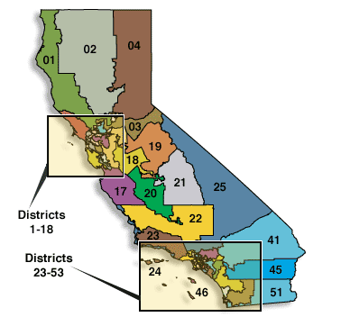
California’s Congressional Districts
This is what our state’s CDs look like:
Remember it’s 1 rep for 650,000 people

Slide 5
The States of Morgana & Matthews
State of Morgana
State of Matthews
You are all a part of The Citizens Committee for Redistricting
Every “person” needs to be represented
1 rep for every 30 “people”
Your task will be to properly apportion and draw district lines based on the population
You are all a part of The Citizens Committee for Redistricting
Every “person” needs to be represented
1 rep for every 30 “people”
Your task will be to properly apportion and draw district lines based on the population

Slide 6
Census 2020
After conducting the new census, the state of Morgana has lost population due to a housing crisis
State of Matthews has an influx of new residents from the state of Morgana
Because of this change in population, the state of Morgana will lose 45 “people”
State of Matthews gains 45 “people”
You must now reapportion and redistrict according to the new census

Slide 7
Rules to remember
Each “district” must still have 1 rep for 30 “people”
You cannot move the “people” to fit the new lines
You must erase old lines and create new lines to follow the proper apportionment

Slide 8
Reflection and takeaways
Take the next 4 mins to respond to the following questions:
Describe your general reactions to this process
Summarize your understanding of reapportionment & redistricting so far
What are your questions/confusions?

Slide 9
The Politics of Redistricting
Questions/Circumstances to Consider:
Most state legislatures are in charge of redrawing the lines (CA uses a citizen’s committee)
What if the majority party in charge of state legislatures have final say in the lines drawn?
Can there be some issues with race in the redrawing of district lines?
The Supreme Court & Issue of “Gerrymandering”
This year alone 4 different cases from 3 different states landed in front of the Court
President Obama has pledged to work on this issue
Obama Statement
Most Recent Cases

Slide 10
Incumbency, Reapportionment, & Redistricting
Unit 2: Interaction Among the Branches

Slide 11
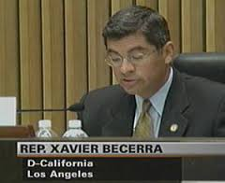
I. Scope of incumbency advantage (What kind of advantages do incumbents have?)
Former Sen. Ted Kennedy (MA)
47 Years in Senate
13 Terms-26 years
HOR
10 Terms-21 Years
HOR

Slide 12
Reelection rate in House :> 90% (96% in 2002)
Reelection rate in Senate :> 80% (86% in 2002)
Relatively few seats are seriously contested in the House. Most are “safe seats.”

Slide 13
Charges of a “Permanent Congress.”
Counter points to these charges:
Assumptions about Incumbents
Retirements open up seats
Thinking: Pros and Cons of having so many incumbents getting re-elected?

Slide 14
II. Advantages of incumbency
Franking privilege
Staffers in offices
Patronage
Name Recognition
Casework
Campaign $ → PACs

Slide 15
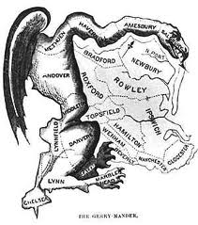
III. A special incumbency advantage for House members: gerrymandering

Slide 16
To understand gerrymandering, you first need to understand reapportionment: the redistribution of the 435 seats in the House on the basis of changes in state populations.
Number of Rep’s per state is determined by population.
Census conducted every 10 years Reapportionment Video

Slide 17
California’s Congressional Districts
This is what our state’s CDs look like:
Remember it’s 1 rep for 650,000 people

Slide 18
Census will show population changes in state → these changes must be reflected in state representation in House; same in the state legislature.
To make the people fit they REDRAW the lines→ Redistricting:
Gerrymandering (type of redistricting): Redrawing boundaries to favor the party in power of the state legislature & HOR
Redistricting Song

Slide 19
Origin of term: from 19th century Mass. Governor Elbridge Gerry, who drew district lines himself. Some of his districts had such strange shapes that they looked like salamanders, prompting one wag to instead refer to them as “gerrymandering”
The party in power can get a majority of seats in the House by:
“Packing:”.
“Cracking:”
Effects of gerrymandering:

Slide 20
IV. Packing vs. Cracking
Take a look at our district here at home...
CA 43rd District

Slide 21
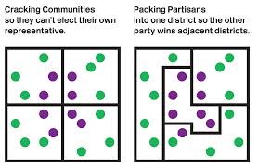
IV. Packing vs. Cracking

Slide 22
A. Redistricting requirements
Districts must be as near equal in population as possible
Baker v. Carr, 1962: “one man, one vote” State of TN was redistricting areas of the state to give benefit to some and leaving others out. Principle applied to state legislative districts to correct overrepresentation (mal-apportionment) of rural areas.
Wesberry V. Sanders, 1964: applied same principal to House districts.

Slide 23
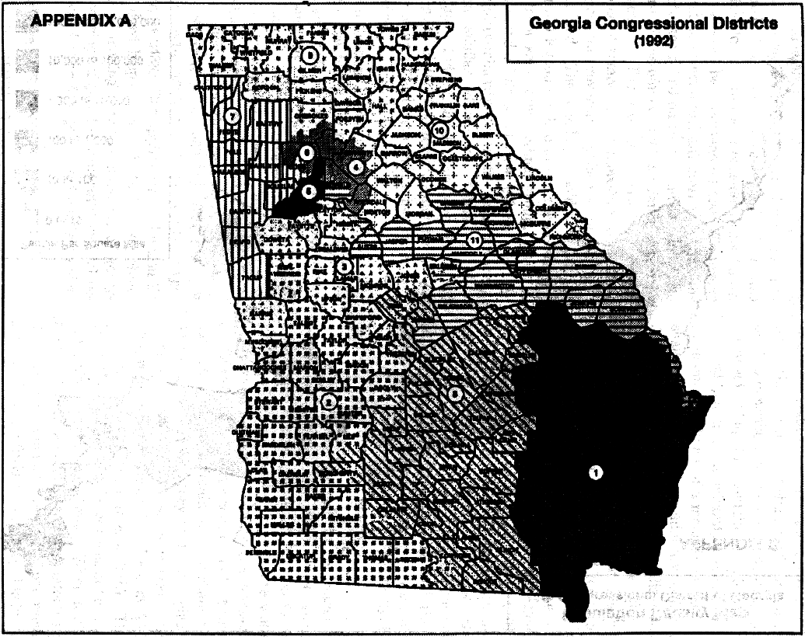
Racial gerrymandering is prohibited(Shaw v. Reno, 1993).
Race may not be the primary factor in drawing district lines (Miller v. Johnson, 1995).

Slide 24
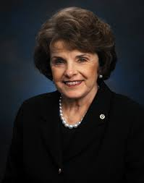
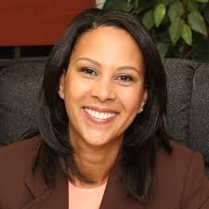
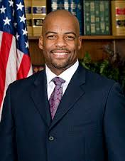
The Importance of Representation
City and County Representation
U.S. Sen
U.S. Sen
HOR
State Assembly
State Senate

Slide 25
V. Impact of Redistricting on Democracy
Changes in Redistricting in California
Prop 11 2008
Challenges of Redistricting in CA
California Lessons on Redistricting

Slide 26
Essential Knowledge Statements
Discuss 2 advantages of incumbents in congressional races.
2. Describe the process of Reapportionment and Redistricting in your own words

Slide 27
Think Like a Political Scientist
Skill: Explain the significance of causes and effects
---------------------------------------------------
How might gerrymandering affect congressional behavior?
Explain how gerrymandering affects gridlock or creates the need for negotiation and compromise in Congress?

