Slide 1
The Structure and Powers of Congress
Unit 2: Interaction Among the Branches

Slide 2
I. The bicameral structure: Two Chambers
“Ceremonial” Upper house = Senate- “Lower House” = HOR
Purpose of bicameralism
HOR reflects popular will of citizens
Senate was to provide more stability, continuity, and in-depth deliberation

Slide 3
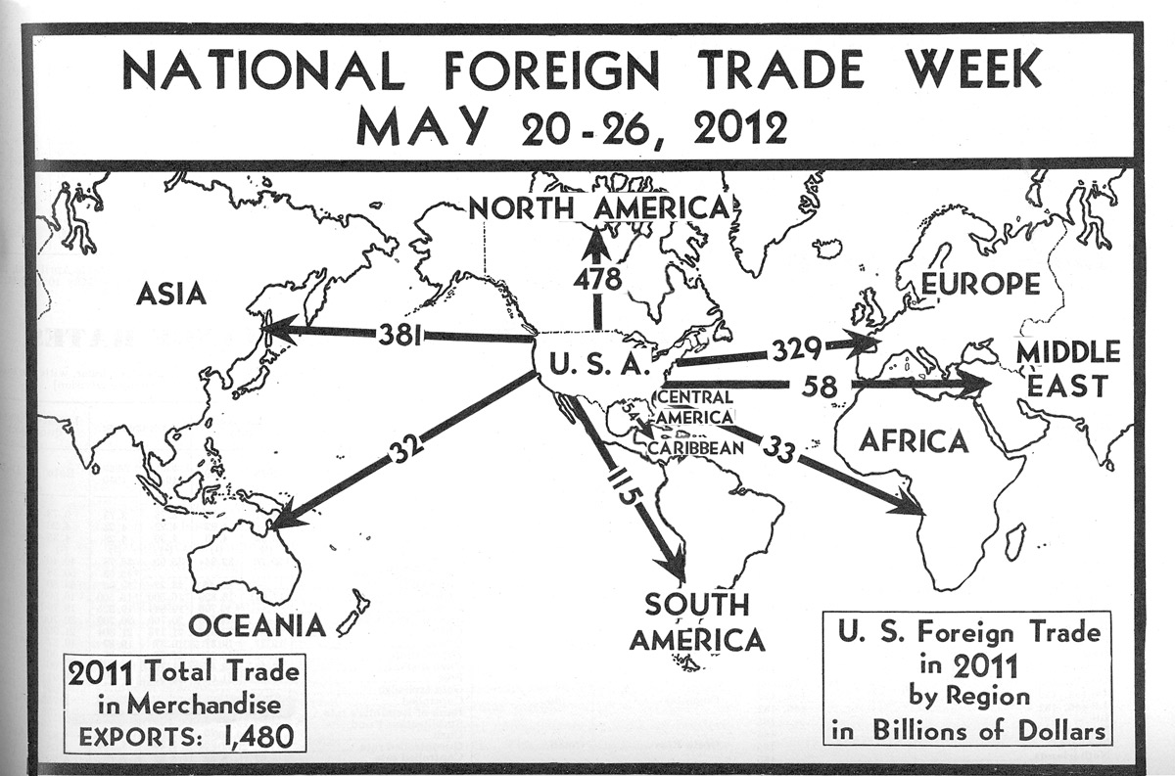
II. Expressed (enumerated, delegated)
Levy taxes (revenue bills must begin in House)
Spend money for common defense and public welfare (appropriations)
Borrow money
Regulate foreign, interstate, Indian commerce. This clause has been tested frequently in the courts due to its broad interpretation by congress

Slide 4
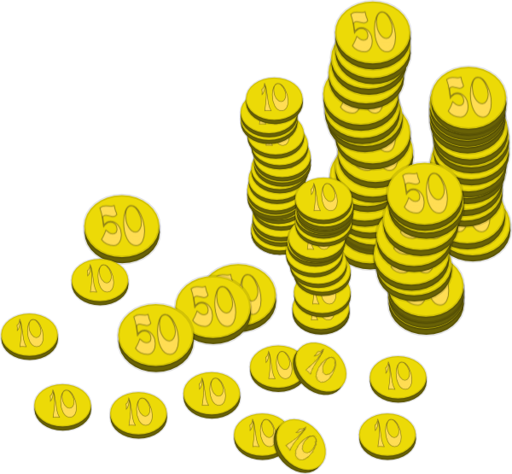
Establish naturalization and bankruptcy laws
Coin money
Establish weights and measurements
Punish counterfeiters
Establish post offices
Grant copyrights and patents
Create courts inferior to Supreme Court

Slide 5
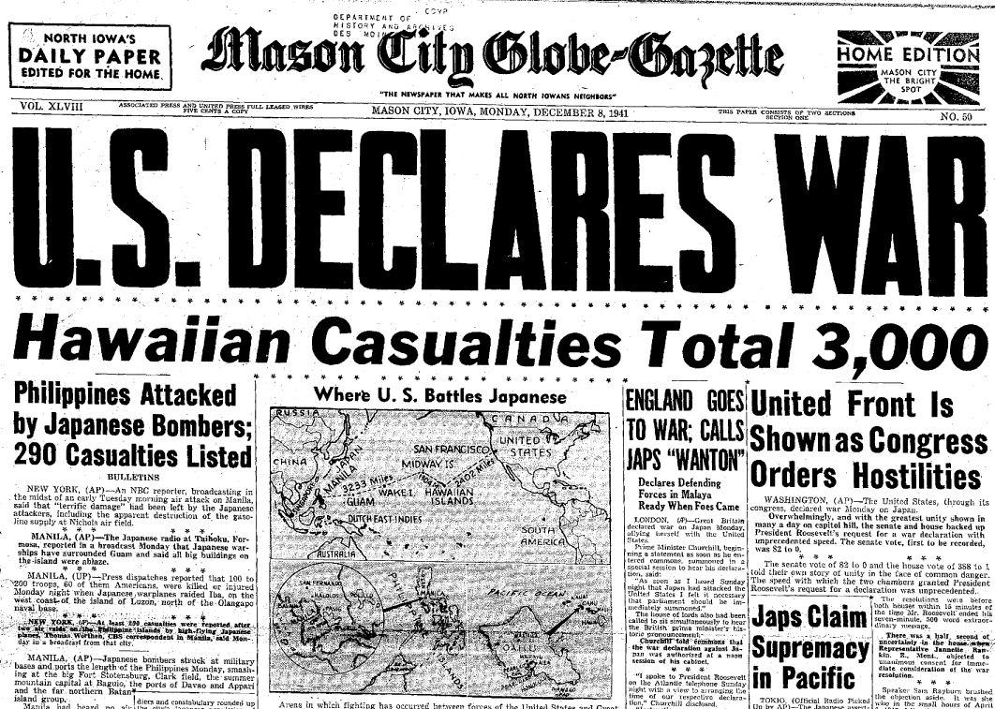
Define and punish piracy
M. Declare war
N. Raise and support an army and navy

Slide 6
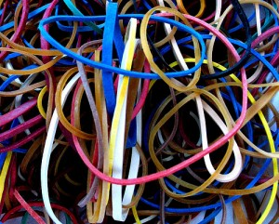
III. Implied powers
Based on elastic clause
Examples: nat. bank, conscription, paper money, air force, CIA
Strict v. loose constructionist approaches

Slide 7
IV. Institutional powers- i.e. those that relate to system of checks and balances: Power #1- Treaty ratification Power #2- Sen. confirmation of pres appts Pwr # 3- HOUSE → Impeaches maj vote Pwr #4- Senate tries for conviction (guilty) 2/3 vote

Slide 8
Examples of Unique Powers
HOR
Senate
ALL revenue (tax) or appropriation (spend) bills START in the HOR
Chooses the President when Electoral College is tied
Impeaches (accuses) elected official
ALL treaties are ratified by Senate 2/3 vote
ALL presidential appointments CONFIRMED by Senate 2/3 vote
Tries the impeached official and decides guilty or innocent (conviction w 2/3 vote)

Slide 9
VI. Powers denied to Congress
Passing ex post facto laws
Passing bills of attainder
Suspending habeas corpus except in cases of rebellion or invasion

Slide 10
Essential Knowledge
Discuss 2 ways implied powers can expand the powers of Congress.
2. Checks and Balances- Explain the relationship between the Senate and the President when it comes to appointments.
3. Add any additional new differences to your HOR/Senate Chart (i.e. Unique powers)

